Slide 1
Assembling the Web – A Tour of WebAssembly
Jason Bock
Practice Lead

Slide 2
Personal Info
http://www.magenic.com
http://www.jasonbock.net
https://www.twitter.com/jasonbock
https://www.github.com/jasonbock
jasonb@magenic.com

Slide 3
Downloads
https://github.com/JasonBock/Presentations/blob/master/
Assembling%20the%20Web%20–%20A%20Tour%20of%20WebAssembly.pptx
https://github.com/JasonBock/AssemblingTheWeb

Slide 4
Overview
History
Details
Conclusion
Remember….
https://github.com/JasonBock/Presentations/blob/master/
Assembling%20the%20Web%20–%20A%20Tour%20of%20WebAssembly.pptx
https://github.com/JasonBock/AssemblingTheWeb

Slide 5

History
http://foodnetwork.sndimg.com/content/dam/images/food/fullset/2008/3/5/0/NY0100_BBQ-Spaghetti.jpg#Spaghetti%20811x608
Notes:
In the beginning, web sites were primarily static content. Sites that added dynamic content ended up with JavaScript that felt like spaghetti code.

Slide 6

History
ES3 (1999) => ES5 (2009) => ES6 (2015) => ES7 (WIP)
Notes:
Over time, JavaScript started to mature, not only in terms of the versions…. . ES3 -> ES5 -> ES6 -> ES7 ...

Slide 7





History
Notes:
But also with libraries like jQuery, Backbone, Angular, Aurelia, moment.js….

Slide 8


History
Notes:
And environments, like Node.js and MongoDB

Slide 9
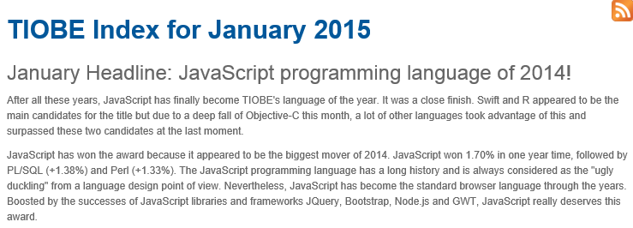
History
http://www.tiobe.com
Notes:
JavaScript has evolved from a small, “script kiddie” glue language to one of the most popular development languages in use.

Slide 10
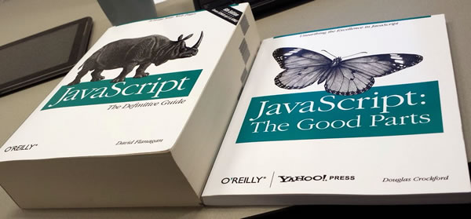
History
http://www.globalnerdy.com/wordpress/wp-content/uploads/2014/08/javascript-and-the-good-parts.jpg
Notes:
But….no matter how much we want to ignore the bad parts and focus on the good parts (and keep making the language better)….

Slide 11
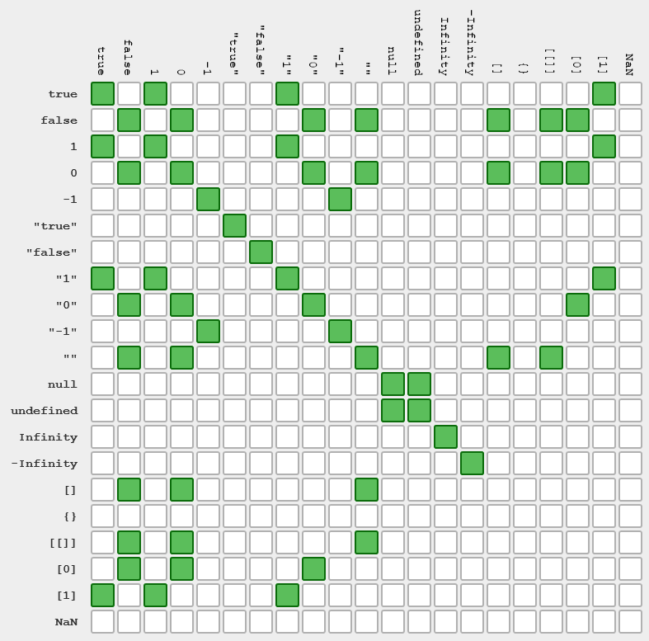
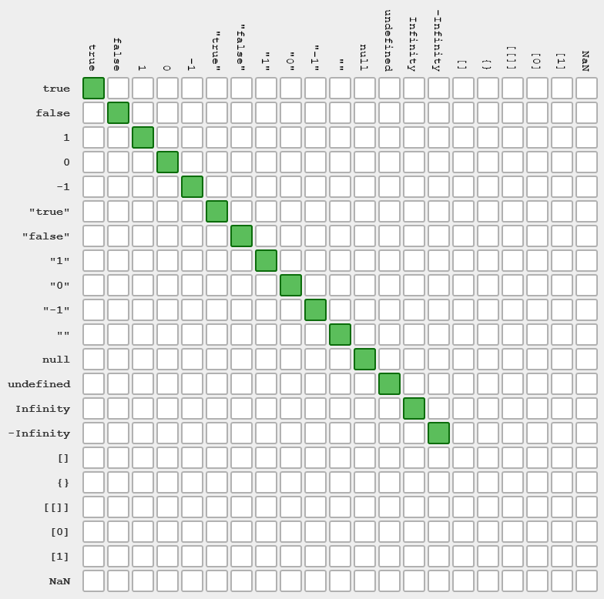
History
true == "1" => TRUE
true === "1" => NOT TRUE
http://dorey.github.io/JavaScript-Equality-Table/
Notes:
There’s a history that has baggage that can’t be removed.

Slide 12
History
1 == "1"
null == undefined
[0] == false
0 == ""
Notes:
That last graph shows what kind of abominations we get if we just use double equals.

Slide 13
History
console.log('4' - 4);
console.log('4' + 4);
0
44
Notes:
There’s a history that has baggage that can’t be removed.

Slide 14
History
Why is the method called includes and not contains?
The latter was the initial choice, but that broke code on the web (MooTools adds this method to Array.prototype).
http://www.2ality.com/2016/02/array-prototype-includes.html
Notes:
There’s a history that has baggage that can’t be removed.

Slide 15

History
https://twitter.com/ThePracticalDev/status/766858028859523072/photo/1c
Notes:
This is why JavaScript may cause some people to do this….

Slide 16

History
Notes:
I personally love JavaScript ;)

Slide 17



History
Notes:
It’s interesting to note that languages like TypeScript are providing transpiling services, or tools provide that capability to a limited extent.

Slide 18
History
Lisp: Code is data
Haskell: Data is code
Ruby: Strings are code
JavaScript: Undefined is not a function
"I'm in love with the Rust type system and going back to JavaScript/ES6 just isn't enough."
https://twitter.com/mattoflambda/status/727290638102876160
https://github.com/rust-lang/rust/issues/33205
Notes:
Let’s face it, developers love other languages (and some don’t have a high opinion of JavaScript)

Slide 19

History
<script type="text/csharp" src="code.cs"></script>
<script type="text/ruby" src="code.rb"></script>
<script type="text/python" src="code.py"></script>
http://memegenerator.net
Notes:
And these developers would probably love to reuse their code in the browser (or Node.js), but there’s no choice. The ONLY language that the web understands is JavaScript.

Slide 20

History
http://blog.cmaresources.org/wp-content/uploads/2012/05/speed2.jpg
Notes:
There’s another issue at play here. JavaScript is an interpreted language. You can use minifiers to reduce the amount of textural JS that you ship to a browser or run in Node, but it has to be interpreted on the fly. There’s a performance cost involved that can’t be eliminated with this approach.

Slide 21
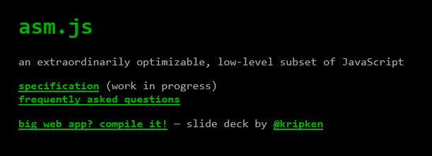

History
http://asmjs.org
http://kripken.github.io/emscripten-site/
Notes:
One popular way to address performance in JavaScript is asm.js. This essentially provides an intermediate language that any language can target, which is done with emscripten

Slide 22
History
C/C++ Code
Clang
emscripten
asm.js
http://asmjs.org
Notes:
Here’s the compilation pipeline for asm.js and emscripten….

Slide 23
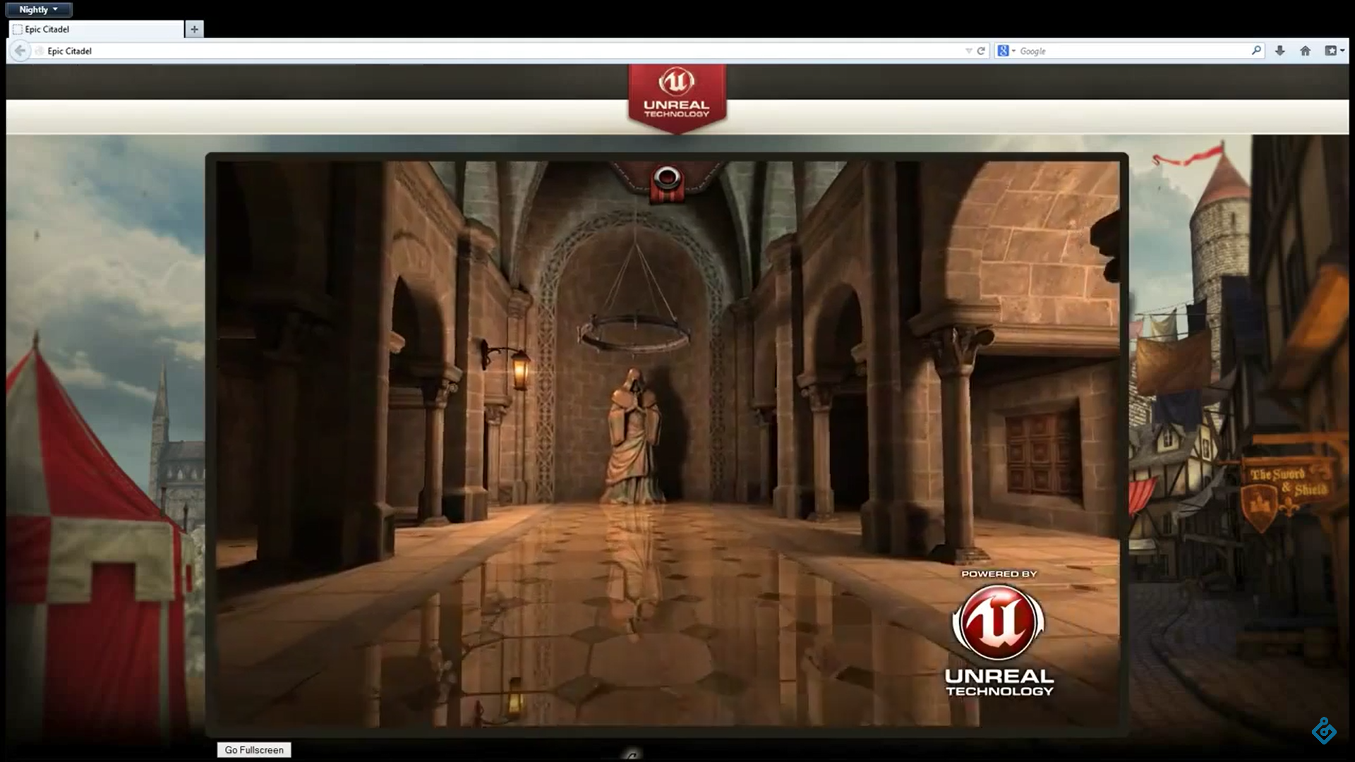
History
https://youtu.be/nB9Pm9Mr7xo
Notes:
….which allows rich, detailed games look awesome in a browser ☺

Slide 24

Details
https://github.com/carlosbaraza/web-assembly-logo
Notes:
Enter WebAssembly

Slide 25
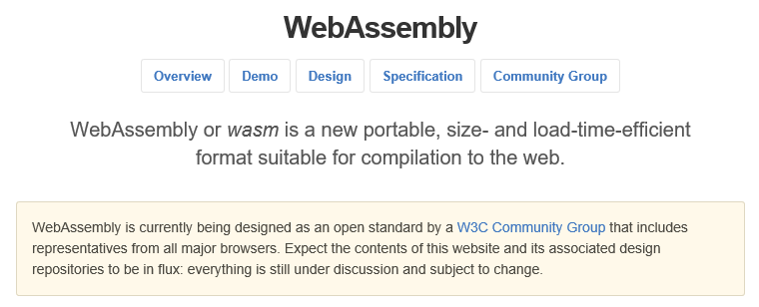
Details
http://webassembly.github.io/
http://webassembly.github.io/
Notes:
WebAssembly is fundamentally the same thing as asm.js, but done as an open standard for web developers.

Slide 26

Details
https://twitter.com/linclark/status/836609222733348864/photo/1
Notes:
Everyone is implementing it

Slide 27
Details
Efficient and fast
Safe
Open and debuggable
Part of the open web platform
http://webassembly.github.io/
Notes:
These come directly from the WebAssembly site:
Overview
•Efficient and fast: The wasm AST is designed to be encoded in a size- and load-time-efficient binary format. WebAssembly aims to execute at native speed by taking advantage of common hardware capabilities available on a wide range of platforms.
•Safe: WebAssembly describes a memory-safe, sandboxed execution environment that may even be implemented inside existing JavaScript virtual machines. When embedded in the web, WebAssembly will enforce the same-origin and permissions security policies of the browser.
•Open and debuggable: WebAssembly is designed to be pretty-printed in a textual format for debugging, testing, experimenting, optimizing, learning, teaching, and writing programs by hand. The textual format will be used when viewing the source of wasm modules on the web.
•Part of the open web platform: WebAssembly is designed to maintain the versionless, feature-tested, and backwards-compatible nature of the web. WebAssembly modules will be able to call into and out of the JavaScript context and access browser functionality through the same Web APIs accessible from JavaScript. WebAssembly also supports non-web embeddings.

Slide 28
Details
Value Types | Description
i32 | 32-bit integer
i64 | 64-bit integer
f32 | 32-bit floating point
f64 | 64-bit floating point
Notes:
Here are the core value types

Slide 29
Details
Operand | Description
i32.load8_s | Load 1 byte and sign-extend i8 to i32
i32.load16_u | Load 2 bytes and zero-extend i16 to i32
f32.load | Load 4 bytes as f32
i32.store16 | Wrap i32 to i16 and store 2 bytes
i64.store16 | Wrap i64 to i16 and store 2 bytes
f64.store | (No conversion) store 8 bytes
Notes:
Here are some opcodes that deal with loading and storing values

Slide 30
Details
Operand | Description
get_local | Read the current value of a local variable
set_local | Set the current value of a local variable
tee_local | Like set_local, but also returns the set value
get_global | Get the current value of a global variable
set_global | Set the current value of a global variable
Notes:
Here’s how you get and set variables

Slide 31
Details
Operand | Description
loop | A block with an additional label at the beginning which may be used to form loops
br_if | Conditionally branch to a given label in an enclosing construct
return | Return zero or more values from this function
Notes:
Here’s some control flow operands

Slide 32

Details
http://www.2112.net/powerwindows/downloads/smartphone960x854/Rush-HoldYourFire2.jpg
Notes:
Now, there are other opcodes to deal with calling methods, perform calculations on values, etc. But let’s switch gears and show a small example using C code. Note, right now, this is kind of a brittle process. Things do work, but you have to be willing to dive into tools and languages that you may not be all that comfortable with, so it may feel like juggling with fire. But hang on!

Slide 33
Demo: Targeting wasm
Assembling the Web – A Tour of WebAssembly

Slide 34
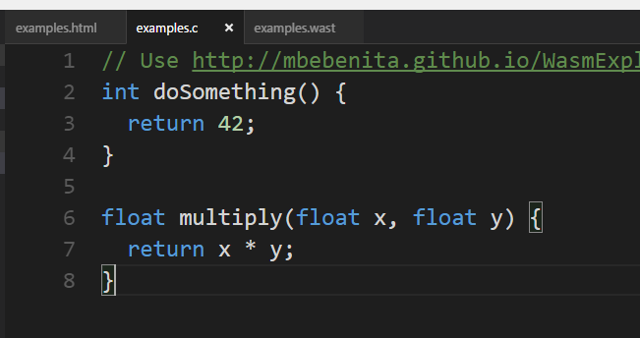
Demo: Targeting wasm

Slide 35
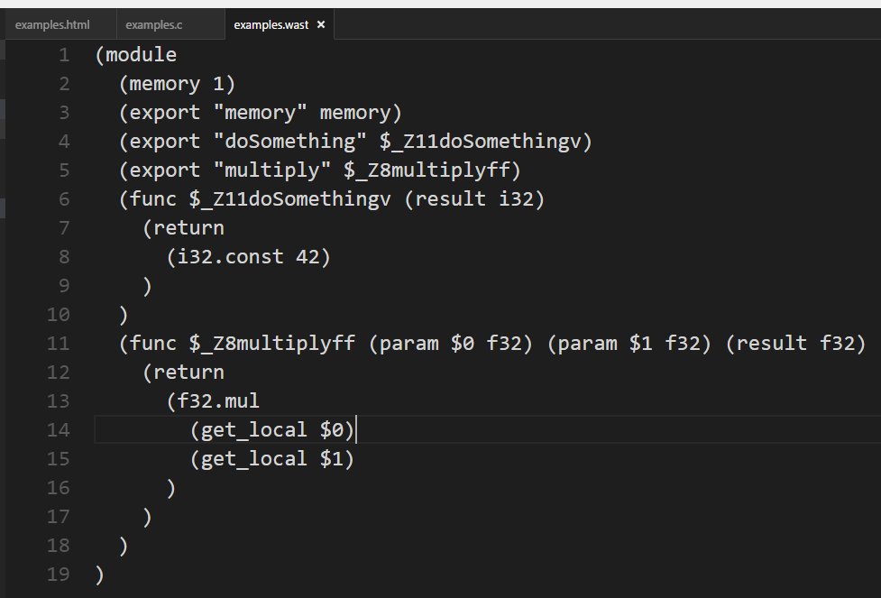
Demo: Targeting wasm

Slide 36
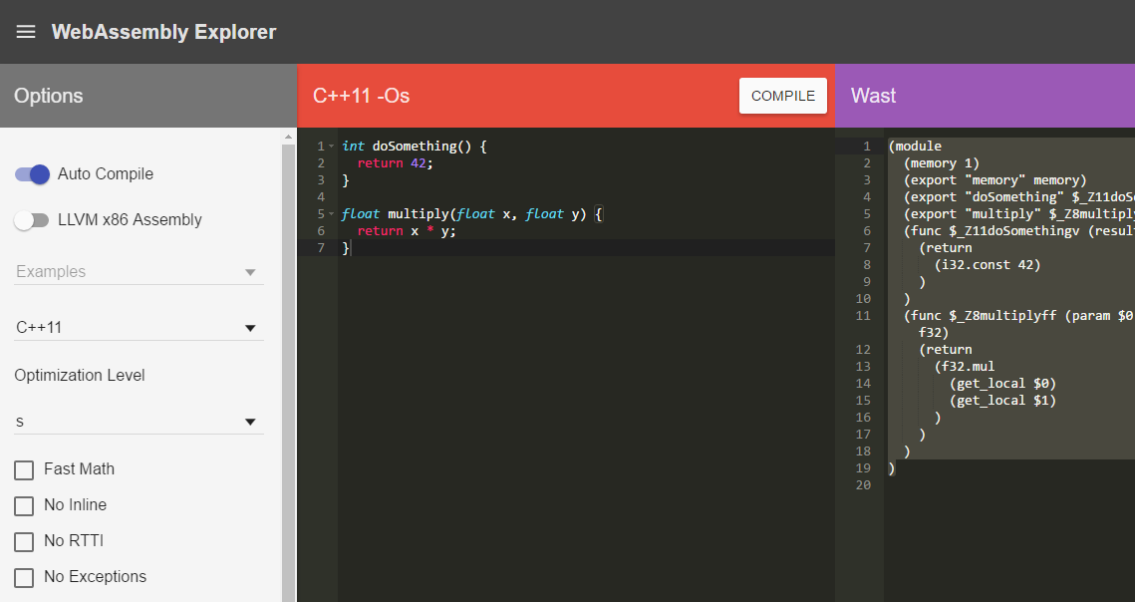
Demo: Targeting wasm

Slide 37
Demo: Targeting wasm
<script>
// https://developer.mozilla.org/en-US/docs/Web/API/Fetch_API/Using_Fetch
var wasmExports;
fetch('examples.wasm')
.then(response =>
response.arrayBuffer())
.then(buffer => {
let codeBytes = new Uint8Array(buffer);
try {
let instance = Wasm.instantiateModule(codeBytes);
wasmExports = instance.exports;
} catch (e) {
alert("Error: " + e);
}
});
</script>

Slide 38
Demo: Targeting wasm
<button onclick='multiplyClick()'>Multiply!</button>
<script>
function multiplyClick() {
alert(wasmExports.multiply(2, 21));
}
</script>

Slide 39
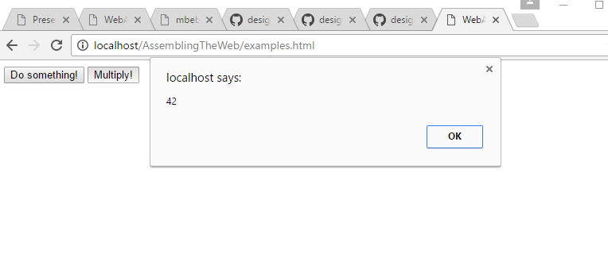
Demo: Targeting wasm

Slide 40

Details
<!-- In the future... -->
<script type="module">
import * as wasmMethods from 'examples.wasm';
alert(wasmMethods.multiply(2, 21));
</script>
https://medium.com/webpack/webpack-awarded-125-000-from-moss-program-f63eeaaf4e15
Notes:
Note that right now, importing code from a wasm file is a little awkward. Eventually, we’ll be able to load and execute the code through the JavaScript module system, which is a natural way to do it. That just doesn’t work right now, but that’s the plan right now, and work has already started

Slide 41

Details
???
Notes:
What about .NET? Will C# eventually target WebAssembly so we can run our code in the browser, or Node.js, or anywhere WebAssembly exists?
(BTW that symbol above C# is F# :))
The answer is a little fuzzy, but….

Slide 42
Details
CoreCLR
https://github.com/dotnet/coreclr
CoreCLR for WASM
JavaScript VM (?)
Notes:
Theoretically, you COULD do this. Compile the CoreCLR (which is all C/C++) to WASM, and then have your C# assemblies target that. But even if you did get that to work, you still have another VM in the browser, so you’re adding in a bunch of overhead just to support C#. Plus, what happens when a C# object wants to talk to JavaScript code that’s managed by its VM? It gets really confusing and ugly in a hurry.

Slide 43
Details
“C# and Java require … GC and stack manipulation primitives. That's also on the roadmap, but after MVP, threads, and dynamic linking.”
“We want to use the rich type information that has been produced by the TypeScript team to produce strongly typed APIs that can be consumed by C# on WebAssembly.”
http://stackoverflow.com/questions/31994034/webassembly-javascript-and-other-languages
https://www.reddit.com/r/programmerchat/comments/4dxpcp/i_am_miguel_de_icaza_i_started_xamarin_mono_gnome/d1v9xyd
Notes:
There is hope, but not until 2017

Slide 44
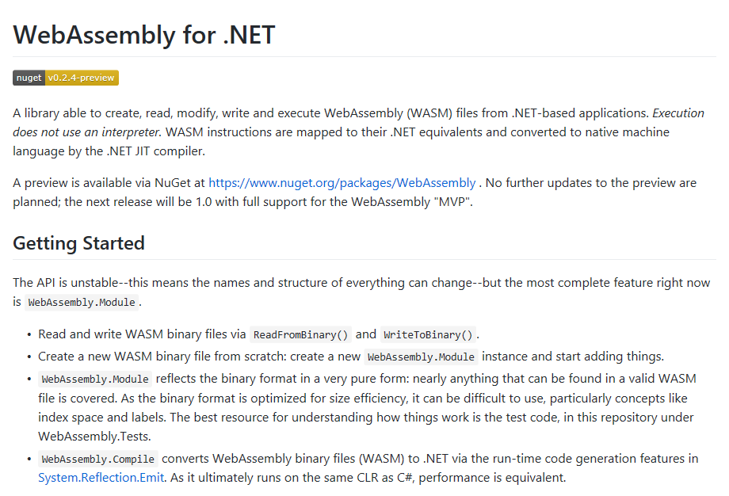
Details
class Program
{
static void Main(string[] args)
{
var module = Compile.FromBinary<dynamic>(
"collatz.wasm");
Console.WriteLine(
module().Exports.collatz(5));
}
}
https://github.com/RyanLamansky/dotnet-webassembly
Notes:
And then there’s this idea: making WASM files .NET assemblies.

Slide 45
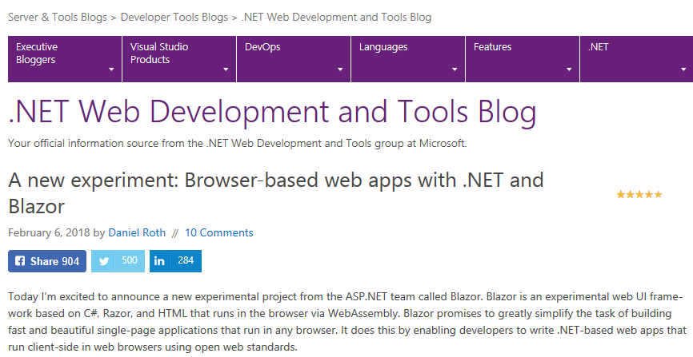
Details
https://blogs.msdn.microsoft.com/webdev/2018/02/06/blazor-experimental-project/
Notes:
People are already creating ways to run C# in the browser. For example, there’s Blazor. And what’s exciting about this is that, it’s no longer a prototype. It’s moved to the ASP.NET team as an experimental feature!

Slide 46
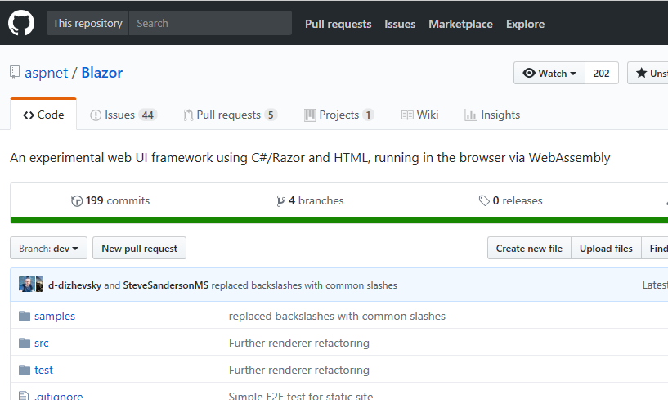
Details
https://blogs.msdn.microsoft.com/webdev/2018/02/06/blazor-experimental-project/
Notes:
Here’s the repo that you can get.

Slide 47
Demo: C# and WASM Experiments
Assembling the Web – A Tour of WebAssembly
Notes:
Let’s play with some of these tools to see what’s already being done in this space.

Slide 48
Conclusion
Greg Reimer, Web Developer
“We won't need to learn wasm any more than C++ programmers need to learn assembly. In the same vein, to remain competitive as developers, we'll need to learn how it fits in our toolchains, which means getting nice and cozy with it. In other words, we'll all be generating wasm, but few of us will actually be writing or debugging it directly.”
https://www.quora.com/What-does-WebAssembly-mean-for-those-who-are-currently-learning-web-development
Notes:
In the end, most developers really won’t have to worry about wasm any more than they do about assembly, .NET IL, Java byte codes, etc.

Slide 49

Conclusion
http://thebridge-can.com/wp-content/uploads/2014/09/Braveheart-Freedom-Slide.jpg
Notes:
But it’s still very important to understand what it gives us: freedom.

Slide 50
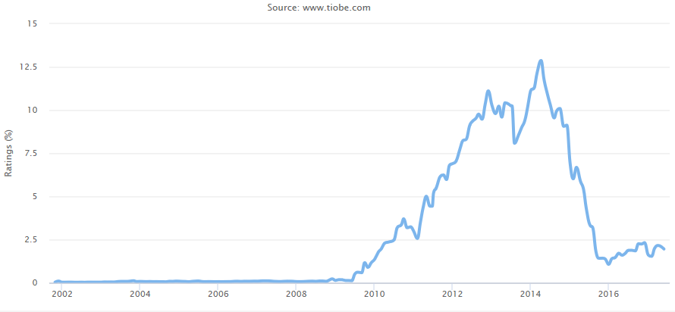



Conclusion
https://www.tiobe.com/tiobe-index/objective-c/
Notes:
Choice is good. Sometimes it can be overwhelming, but if developers can choose a language that they are comfortable with and feel productive in, the environment really shouldn’t be a constraint, especially on the web. With Swift (and to some degree, Xamarin), it’s clear that developers are starting to move away from Objective-C to other choices.

Slide 51


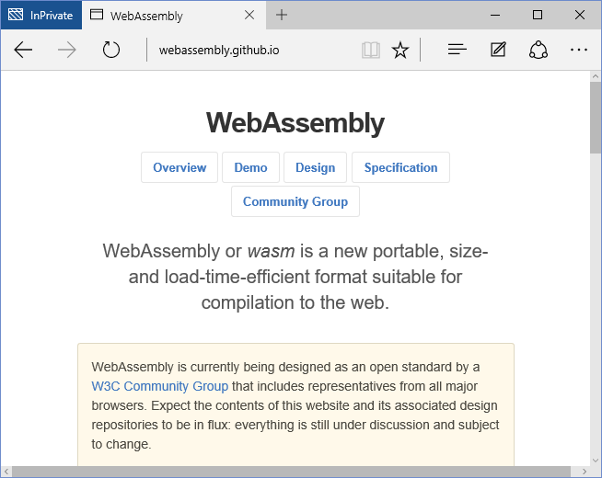





Conclusion
Notes:
Will this happen when wasm becomes mainstream? Time will tell….

Slide 52




Conclusion
Notes:
….but I’m confident ☺

Slide 53
Assembling the Web – A Tour of WebAssembly
Jason Bock
Practice Lead
Remember…
https://github.com/JasonBock/Presentations/blob/master/Assembling%20the%20Web%20–%20A%20Tour%20of%20WebAssembly.pptx
https://github.com/JasonBock/AssemblingTheWeb
References in the notes on this slide
Notes:
Performance Links/Demos:
Can I Use Wasm: http://caniuse.com/#feat=wasm
Hashing - https://antelle.github.io/argon2-browser/
Animation Demo - http://aws-website-webassemblyskeletalanimation-ffaza.s3-website-us-east-1.amazonaws.com/
Autocad Client360 - https://client.autocad360.com/#/filemanager.html
WebAssembly: A New Hope - https://pspdfkit.com/blog/2017/webassembly-a-new-hope/
CoreRT: C:\corert\tests\src\Simple\HelloWasm\HelloWasm.csproj
Websight.js - https://www.websightjs.com/
References:
A new experiment: Browser-based web apps with .NET and Blazor - https://blogs.msdn.microsoft.com/webdev/2018/02/06/blazor-experimental-project/
Blazor: a technical introduction - http://blog.stevensanderson.com/2018/02/06/blazor-intro/
Blazor repo - https://github.com/aspnet/blazor
Oxidizing Source Maps with Rust and WebAssembly - https://hacks.mozilla.org/2018/01/oxidizing-source-maps-with-rust-and-webassembly/
Add WebAssembly CoreFX build architecture - https://github.com/dotnet/corefx/issues/26107
Asteroids in WebAssembly - https://github.com/m1el/wasm-asteroids
Dose Response ported to WebAssembly! - https://aimlesslygoingforward.com/blog/2017/12/25/dose-response-ported-to-webassembly/
Running Blazor on Mono in the browser - http://blog.stevensanderson.com/2017/11/05/blazor-on-mono/
CoreRT
WebAssembly Design - https://github.com/dotnet/corert/blob/e6d0a9398e3d8fc83d047cccda302ed13610f190/Documentation/design-docs/WebAssembly-design.md
Build WebAssembly - https://github.com/dotnet/corert/blob/e6d0a9398e3d8fc83d047cccda302ed13610f190/Documentation/how-to-build-WebAssembly.md
webpack awarded $125,000 from MOSS Program - https://medium.com/webpack/webpack-awarded-125-000-from-moss-program-f63eeaaf4e15
Experimenting with WebAssembly and Computer Vision - https://hacks.mozilla.org/2017/09/bootcamps-webassembly-and-computer-vision/
WebAssembly and Blazor with Steve Sanderson - http://www.dotnetrocks.com/?show=1455
Web Apps can’t really do *that*, can they? - Steve Sanderson - https://www.youtube.com/watch?v=MiLAE6HMr10
Blazor - https://github.com/SteveSanderson/Blazor
DotNetAnywhere - https://github.com/chrisdunelm/DotNetAnywhere
.NET and WebAssembly - Is this the future of the front-end? - https://www.hanselman.com/blog/NETAndWebAssemblyIsThisTheFutureOfTheFrontend.aspx
WebAssembly: A New Hope - https://pspdfkit.com/blog/2017/webassembly-a-new-hope/
Hello WebAssembly (Mono on WebAssembly) - http://www.mono-project.com/news/2017/08/09/hello-webassembly/
Pass a JavaScript array as argument to a WebAssembly function - https://stackoverflow.com/questions/41875728/pass-a-javascript-array-as-argument-to-a-webassembly-function
Using the WebAssembly JavaScript API - https://developer.mozilla.org/en-US/docs/WebAssembly/Using_the_JavaScript_API
WebAssembly 101: a developer's first steps - http://blog.openbloc.fr/webassembly-first-steps/
WebAssembly references - https://pinboard.in/u:callahad
Curated list of awesome things regarding WebAssembly (wasm) ecosystem - https://github.com/mbasso/awesome-wasm
How to get a performance boost using WebAssembly - https://hackernoon.com/how-to-get-a-performance-boost-using-webassembly-8844ec6dd665#.beosqm1u6
A cartoon intro to WebAssembly - https://hacks.mozilla.org/2017/02/a-cartoon-intro-to-webassembly/
Previewing the WebAssembly Explorer - https://hacks.mozilla.org/2017/03/previewing-the-webassembly-explorer/
Firefox 52: Introducing Web Assembly, CSS Grid and the Grid Inspector - https://hacks.mozilla.org/2017/03/firefox-52-introducing-web-assembly-css-grid-and-the-grid-inspector/
WebAssembly consensus and end of Browser Preview - https://lists.w3.org/Archives/Public/public-webassembly/2017Feb/0002.html
WebAssembly logo voting - https://github.com/WebAssembly/design/issues/980
WebAssembly: http://webassembly.org/
WebAssembly: A New Compilation Target for the Web - https://www.infoq.com/presentations/webassembly
Will there be a JS -> WASM compiler? - https://github.com/WebAssembly/design/issues/219
WebAssembly Explorer - http://mbebenita.github.io/WasmExplorer/
What the Heck is WebAssembly, and do I Have to Learn C Now? - https://callahad.github.io/ow16-wasm/
WebAssembly - Text Format - https://github.com/WebAssembly/design/blob/master/TextFormat.md
WasmFiddle: https://wasdk.github.io/WasmFiddle/
WebGL: WebAssembly and Feature Roadmap - https://blogs.unity3d.com/2015/06/18/webgl-webassembly-and-feature-roadmap/
Why I Moved to Vue.js from Angular 2 (read the comments) - http://wildermuth.com/2017/02/12/Why-I-Moved-to-Vue-js-from-Angular-2
JavaScript Start-up Performance - https://medium.com/dev-channel/javascript-start-up-performance-69200f43b201#.efyl6by7v
Compiling Rust to your Browser - https://badboy.github.io/rust-to-the-browser/#1 and http://www.hellorust.com/emscripten/
Compiling to WebAssembly: It’s Happening! - https://hacks.mozilla.org/2015/12/compiling-to-webassembly-its-happening/
A WebAssembly Milestone: Experimental Support in Multiple Browsers - https://hacks.mozilla.org/2016/03/a-webassembly-milestone/
WebAssembly - https://hacks.mozilla.org/?s=webassembly
WebAssembly: Finally Freed from JavaScript? - https://simpleprogrammer.com/2016/05/25/webassembly-finally-freed-javascript/
[Video] Talk on transpiling C/C++ to JavaScript with Emscripten - http://www.davevoyles.com/20321-2/
Asm.js and WebGL for Unity and Unreal Engine - http://www.davevoyles.com/asm-js-and-webgl-for-unity-and-unreal-engine/
WebAssembly, JavaScript, and other languages - http://stackoverflow.com/questions/31994034/webassembly-javascript-and-other-languages
WebSharp - https://github.com/xamarin/WebSharp
Taking Rust everywhere with rustup - https://blog.rust-lang.org/2016/05/13/rustup.html
Rust and Wasm - https://github.com/rust-lang/rust/issues/33205

